Slide 1
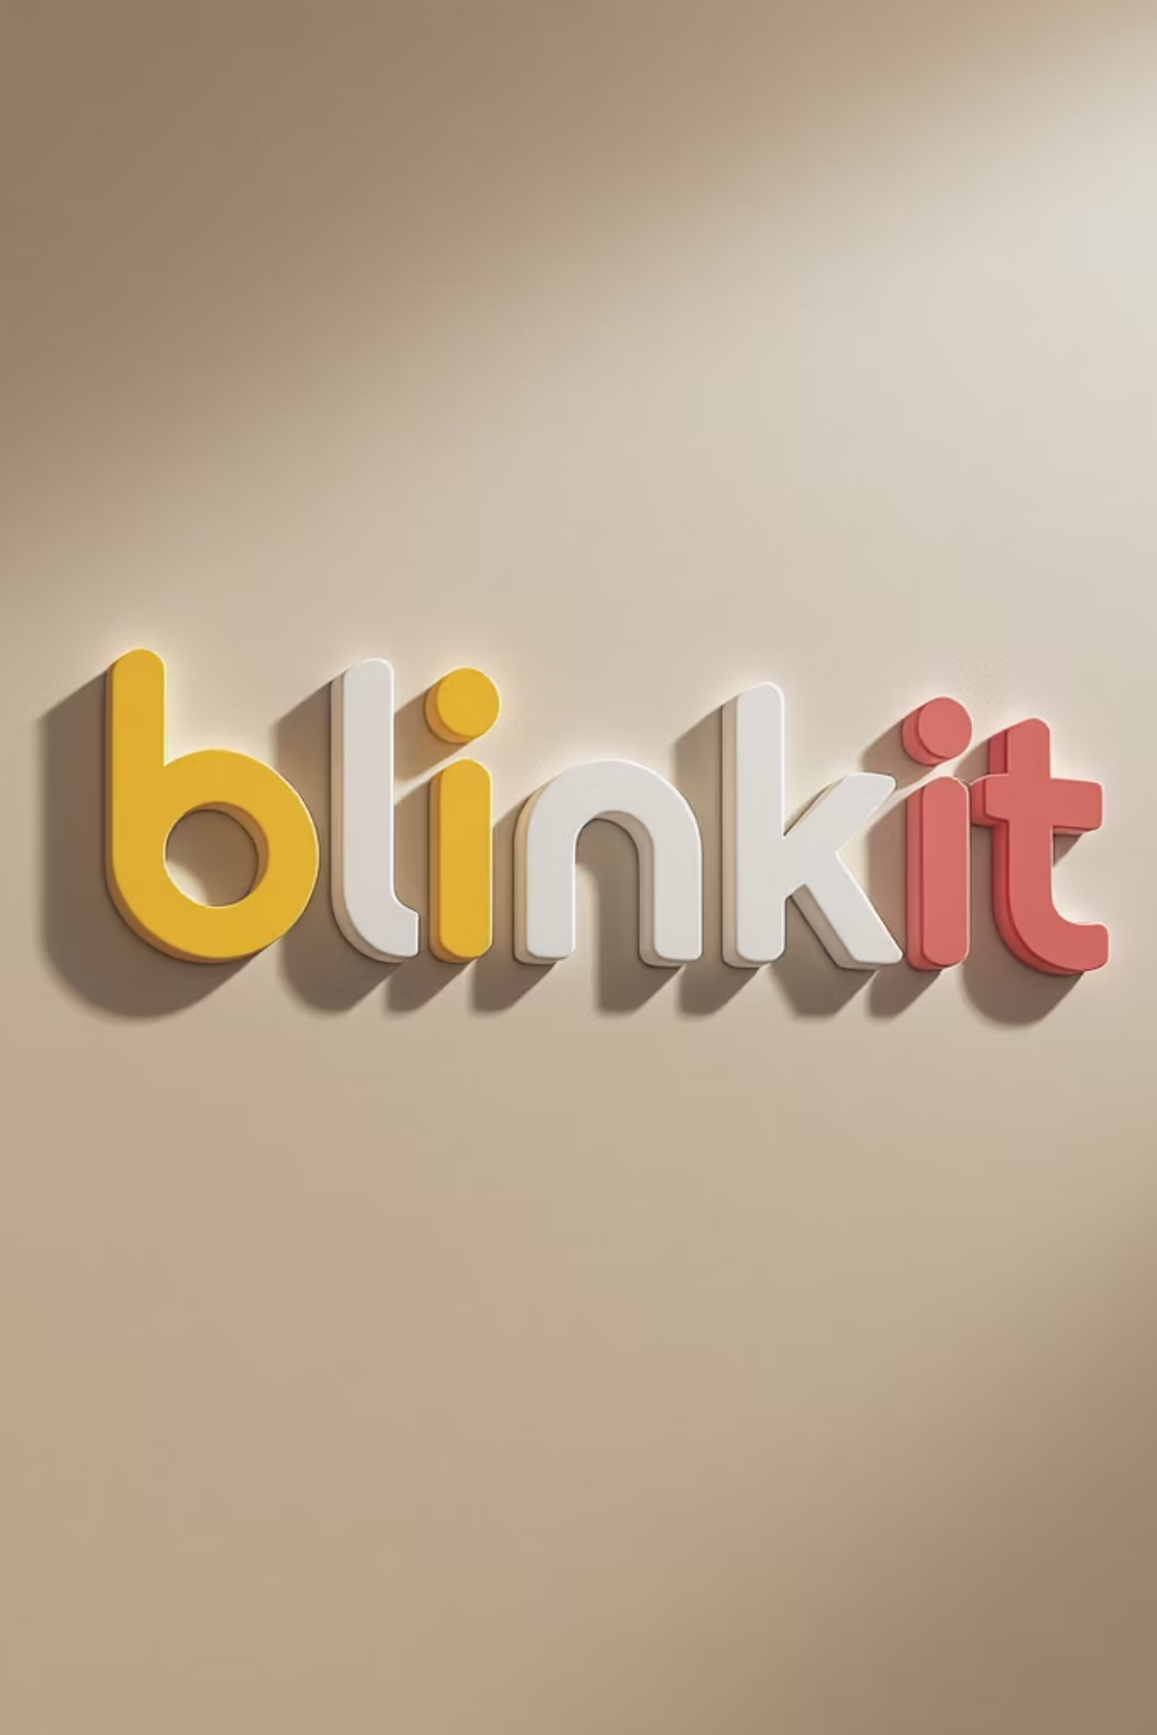
Blinkit Customer Feedback Analytics
Strategic Insights from User Sentiment & Engagement Patterns
A comprehensive analysis of customer feedback patterns reveals critical insights about user engagement, sentiment distribution, and strategic opportunities for enhancing customer experience and retention.

Slide 2
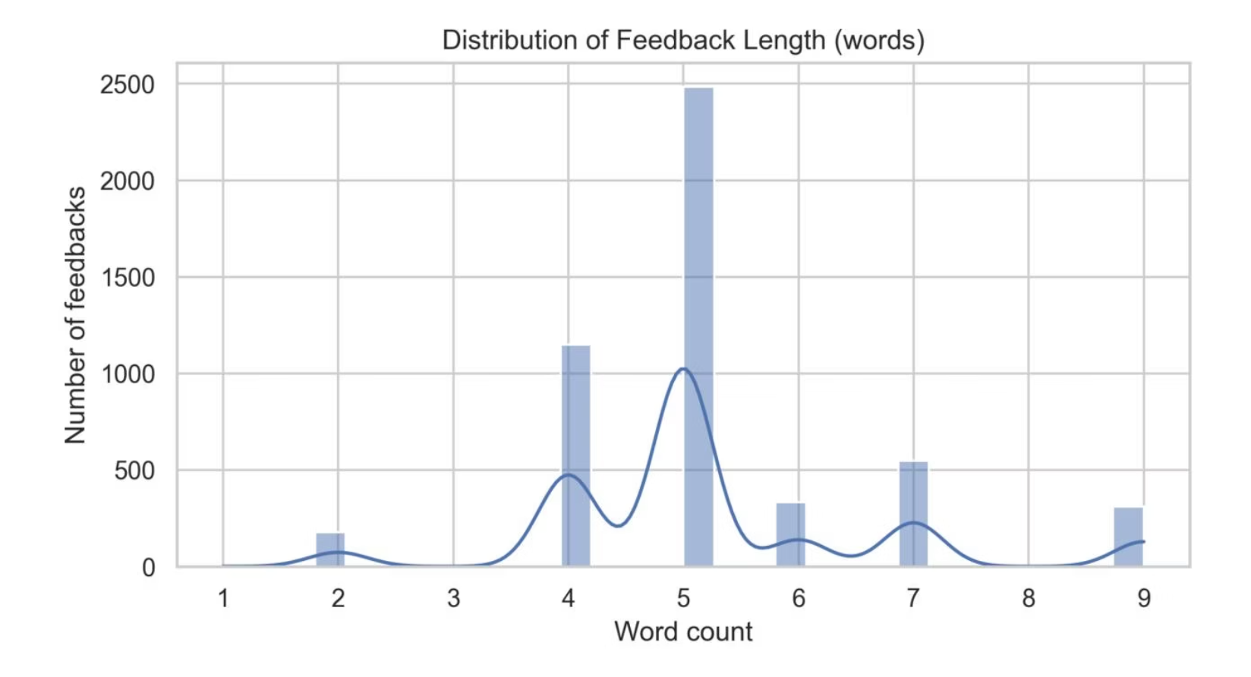

Distribution of Feedback Length
Quick Response Preference
Most feedbacks are short, ranging from 4-6 words, showing users prefer quick in-app responses. This pattern indicates frictionless engagement but limited qualitative depth.
Strategic Takeaway: Add 'Detailed feedback' prompts for deeper insights, especially on low ratings to capture more actionable data.

Slide 3

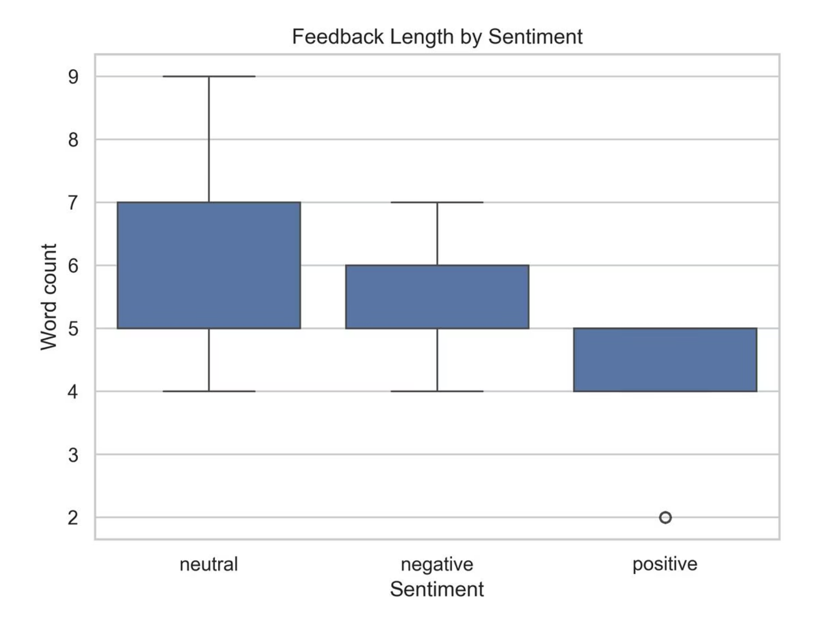
Feedback Length by Sentiment
Neutral Feedback
Positive Feedback
Tends to be longer and more descriptive, providing detailed context about user experience
Shorter and more concise, often expressing satisfaction without extensive detail
Strategic Insight
Analyze neutral comments for early dissatisfaction warnings and potential churn prevention opportunities

Slide 4
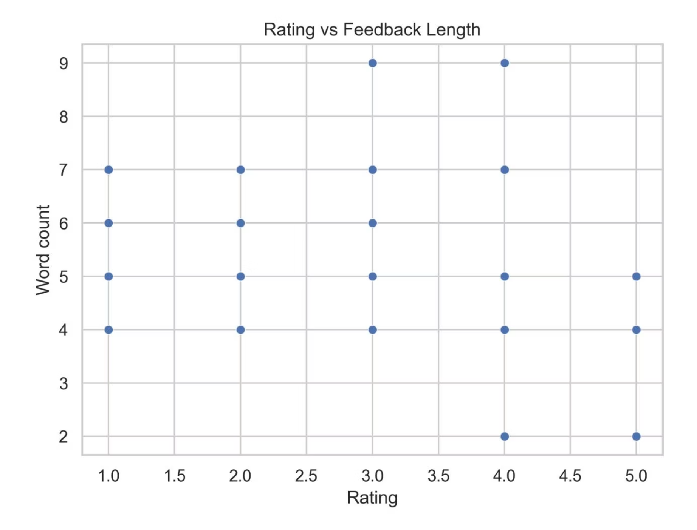

Rating vs Feedback Length
Sentiment Over Rating
Feedback length remains constant across ratings, showing sentiment, not rating, reveals deeper meaning. This pattern suggests that star ratings alone don't capture the full story.
Key Finding: The consistency across ratings indicates users provide similar effort regardless of satisfaction level.
Strategic Takeaway: Add structured reason tags (Late Delivery, Wrong Item) for better insights beyond star ratings.

Slide 5
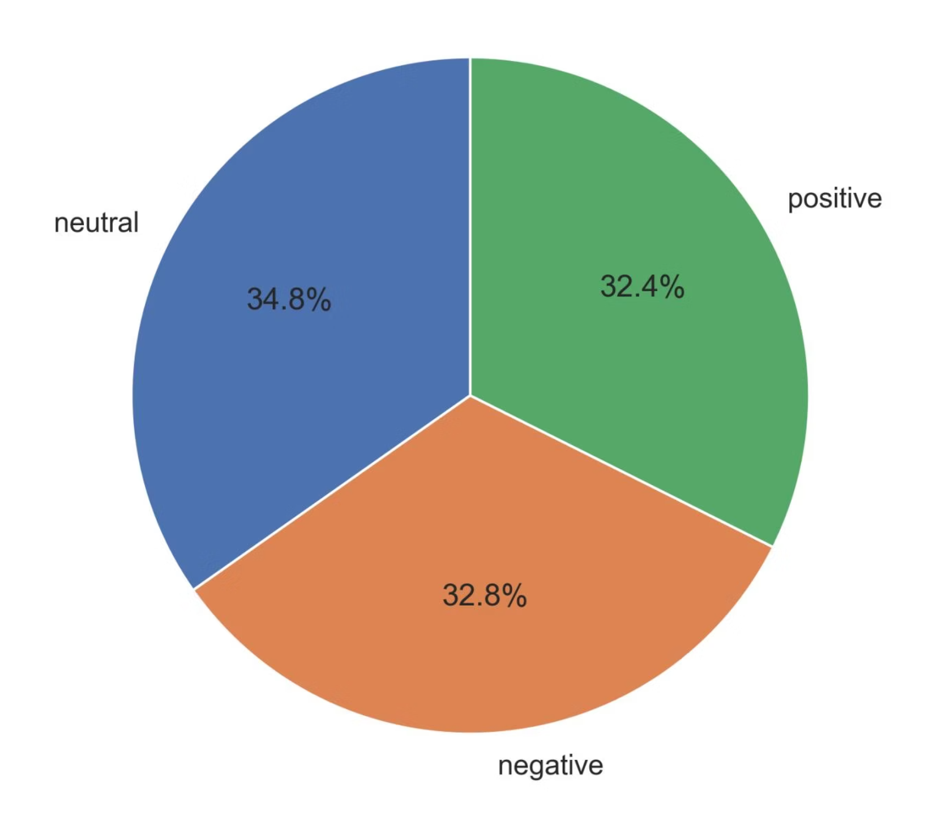
Sentiment Distribution Analysis
Balanced Yet Polarized
Sentiments are evenly distributed at approximately 33% each for positive, neutral, and negative feedback. This balance reveals a polarized yet passive customer base without strong brand advocacy.
The equal distribution signals brand neutrality risk - customers are neither strongly loyal nor actively dissatisfied.
Strategic Takeaway: Re-engage neutral customers through personalized outreach to shift sentiment positive and build advocacy.

Slide 6

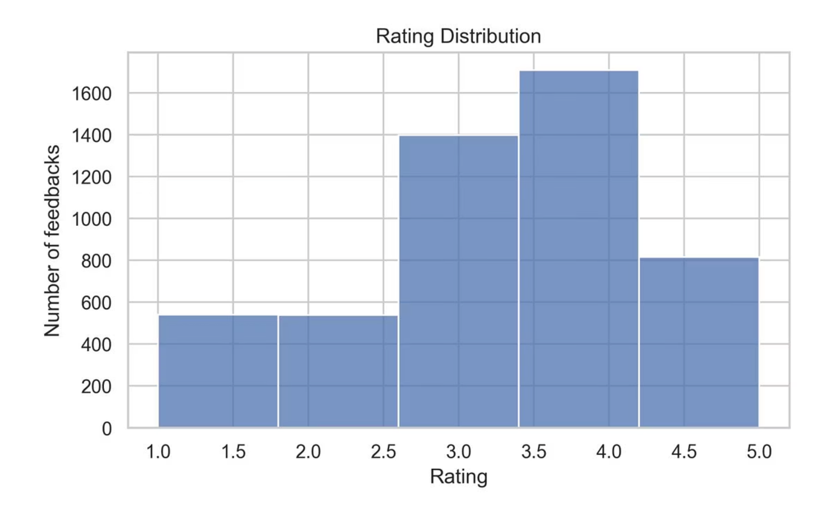
Rating Distribution Patterns
3-4 Star Clustering
Ratings cluster around 3-4 stars, reflecting stable but unenthusiastic satisfaction levels across the customer base
Retention Without Advocacy
This pattern indicates retention is stable but advocacy remains weak - customers stay but don't actively promote
Opportunity for Delight
Introduce delight elements like discounts, thank-you notes, or surprise rewards to turn 4-star users into brand promoters

Slide 7
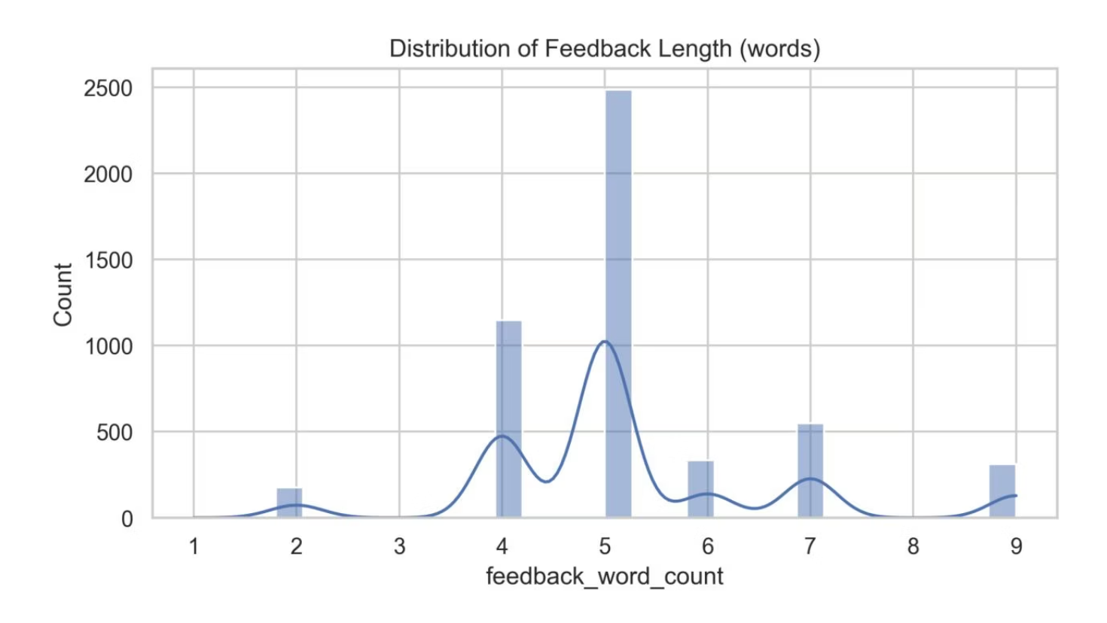
Feedback Communication Style
The 5-Word Standard
Analysis confirms a 5-word feedback mode, demonstrating users prefer short and concise communication. This pattern validates the app's frictionless feedback UX design.
However, this brevity limits qualitative depth and actionable insights. While efficient, the current system captures what users think but not always why they think it.

Slide 8
Key Analytical Patterns
01
02
03
Brief, Consistent Feedback
Sentiment Balance Risk
Neutral as Predictor
Customers provide efficient engagement but shallow detail, signaling need for deeper qualitative capture
Equal satisfaction and dissatisfaction creates brand neutrality risk without strong advocacy
Neutral sentiment predicts potential churn - act before users turn negative
04
05
Satisfaction Without Delight
Operational Correlation
Ratings show retention is stable but advocacy weak - customers satisfied but not excited
Feedback patterns link to operational or campaign changes, enabling strategic learning opportunities

Slide 9


Strategic Recommendations
Capture Deeper Data
Implement 'reason tags' and open-text options to capture more qualitative data beyond brief responses
Monitor Neutral Sentiment
Track neutral sentiment closely to detect early dissatisfaction signals before churn occurs
Create Wow Moments
Introduce delight elements to transform passive users into brand promoters and advocates
Track Monthly KPIs
Use monthly feedback data as an internal KPI for operational health and customer satisfaction trends

